Slide 1

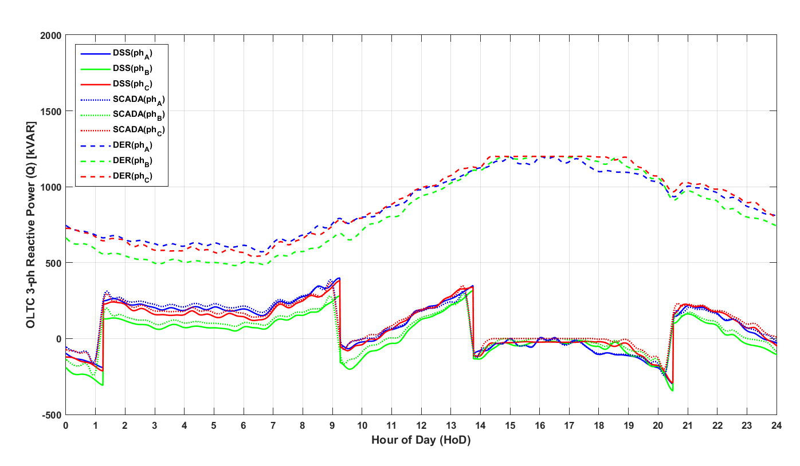
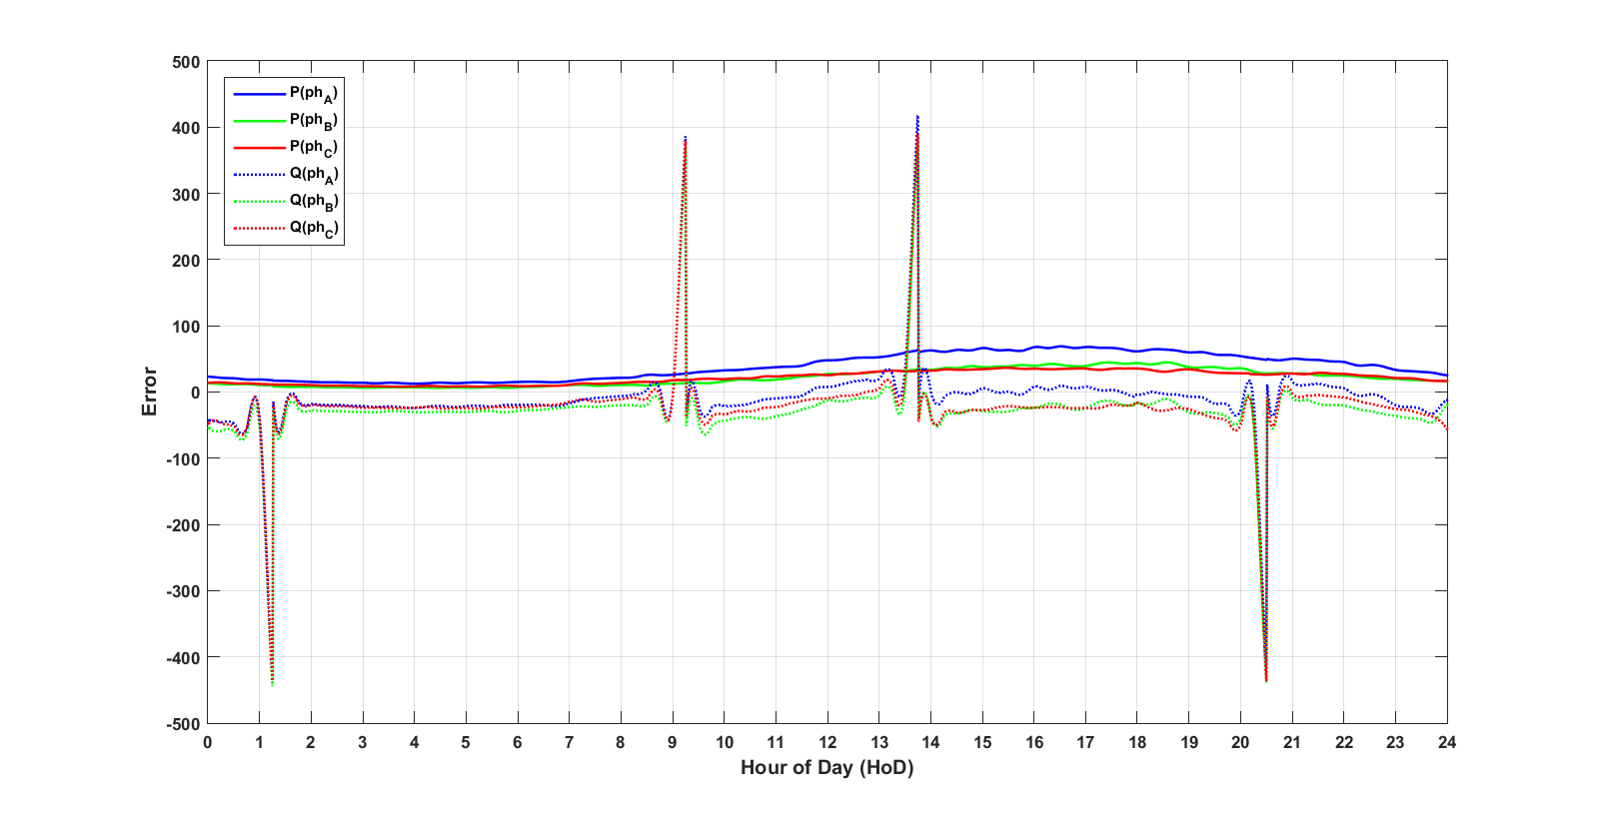
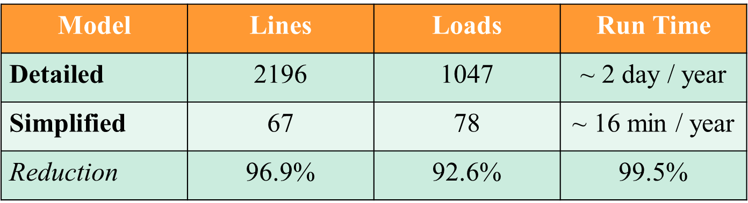

Feeder Reduction
Joshua M. B. Smith, Undergraduate Research Assistant
Figure 3a – 24 Hour QSTS
Figure 3b – 24 Hour QSTS Error
The power of computerized DER planning lies in the ability to programmatically iterate through cases with different configurations
QSTS simulations are accurate but timely
Reduction capitalizes on efficiency without considerable loss of accuracy

Slide 2
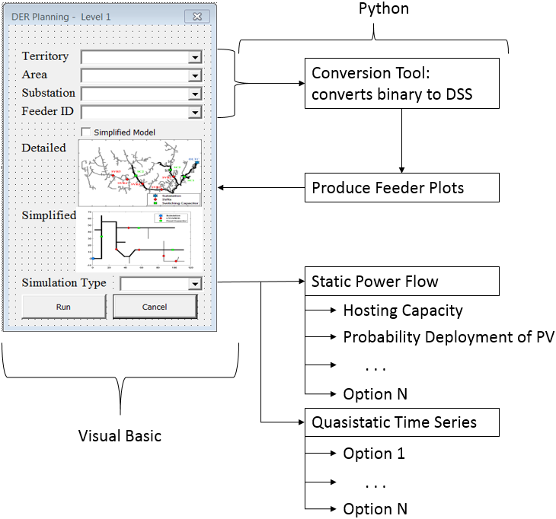
Future Research Objectives
Joshua M. B. Smith, Undergraduate Research Assistant
Reduced Feeders
Expansion of feeder reduction criteria and methods
Examination of VOLT / VAR control on reduced feeder
Holistic Planning Tool
Development of GUI in VBA
Transition to open-source code by translation of MATLAB to Python with hopes of improved efficiency
Figure 5 – Holistic DER Planning Tool

